Slide 1

Basic Details of the Team and Problem Statement
Ministry/Organization Name/Student Innovation:
Ministry of AYUSH
PS Code: SIH1340 Problem Statement Title:
Application for Assessment of Quality of Textbook/ Reference Books/ E- Book
Team Name: GrowGuards Team Leader Name: Uzzma Saiyed Institute Code (AISHE): C-58356 Institute Name:
Faculty of Computer Applications and IT
Theme Name: Smart Education

Slide 2
































Idea/Approach Details
IDEA DESCRIPTION:
This application helps users to choose high-quality textbooks, reference books, and
e-books. The application will allow users to leave comments and ratings based on quality assessment scale on books. The reviewed data will then be categorized and summarized though AI. This application aims to empower educators, students, and educational institutions by providing them with a reliable platform to assess the quality and suitability of educational materials.
User is Confused About Which Book To Read ?
PROCESS FLOW CHART
User Opens App
User
User Submits book
for review
Book is Assigned to reviewers
User Rates Book
User leaves comments or reviews
Reviewers Will Review The Book
TECHNOLOGY STACK
User decides to use the book or not.
User Gets Endorsement From Other Users Or Administrators
Reviewers Will Provide Feedback
Front-End
Tech Stack
Middleware
Tech Stack
Back-End
Tech Stack
Database
Servers
Summarizing Feedbacks Using AI Capabilities
Users views The Assessments
Logout
Text To GPT3 Summarization API
Flutter
Rest API
Python
Firebase+ MySQL
Apache
API response With Summery
User Gets Summary of All The Reviews

Slide 3
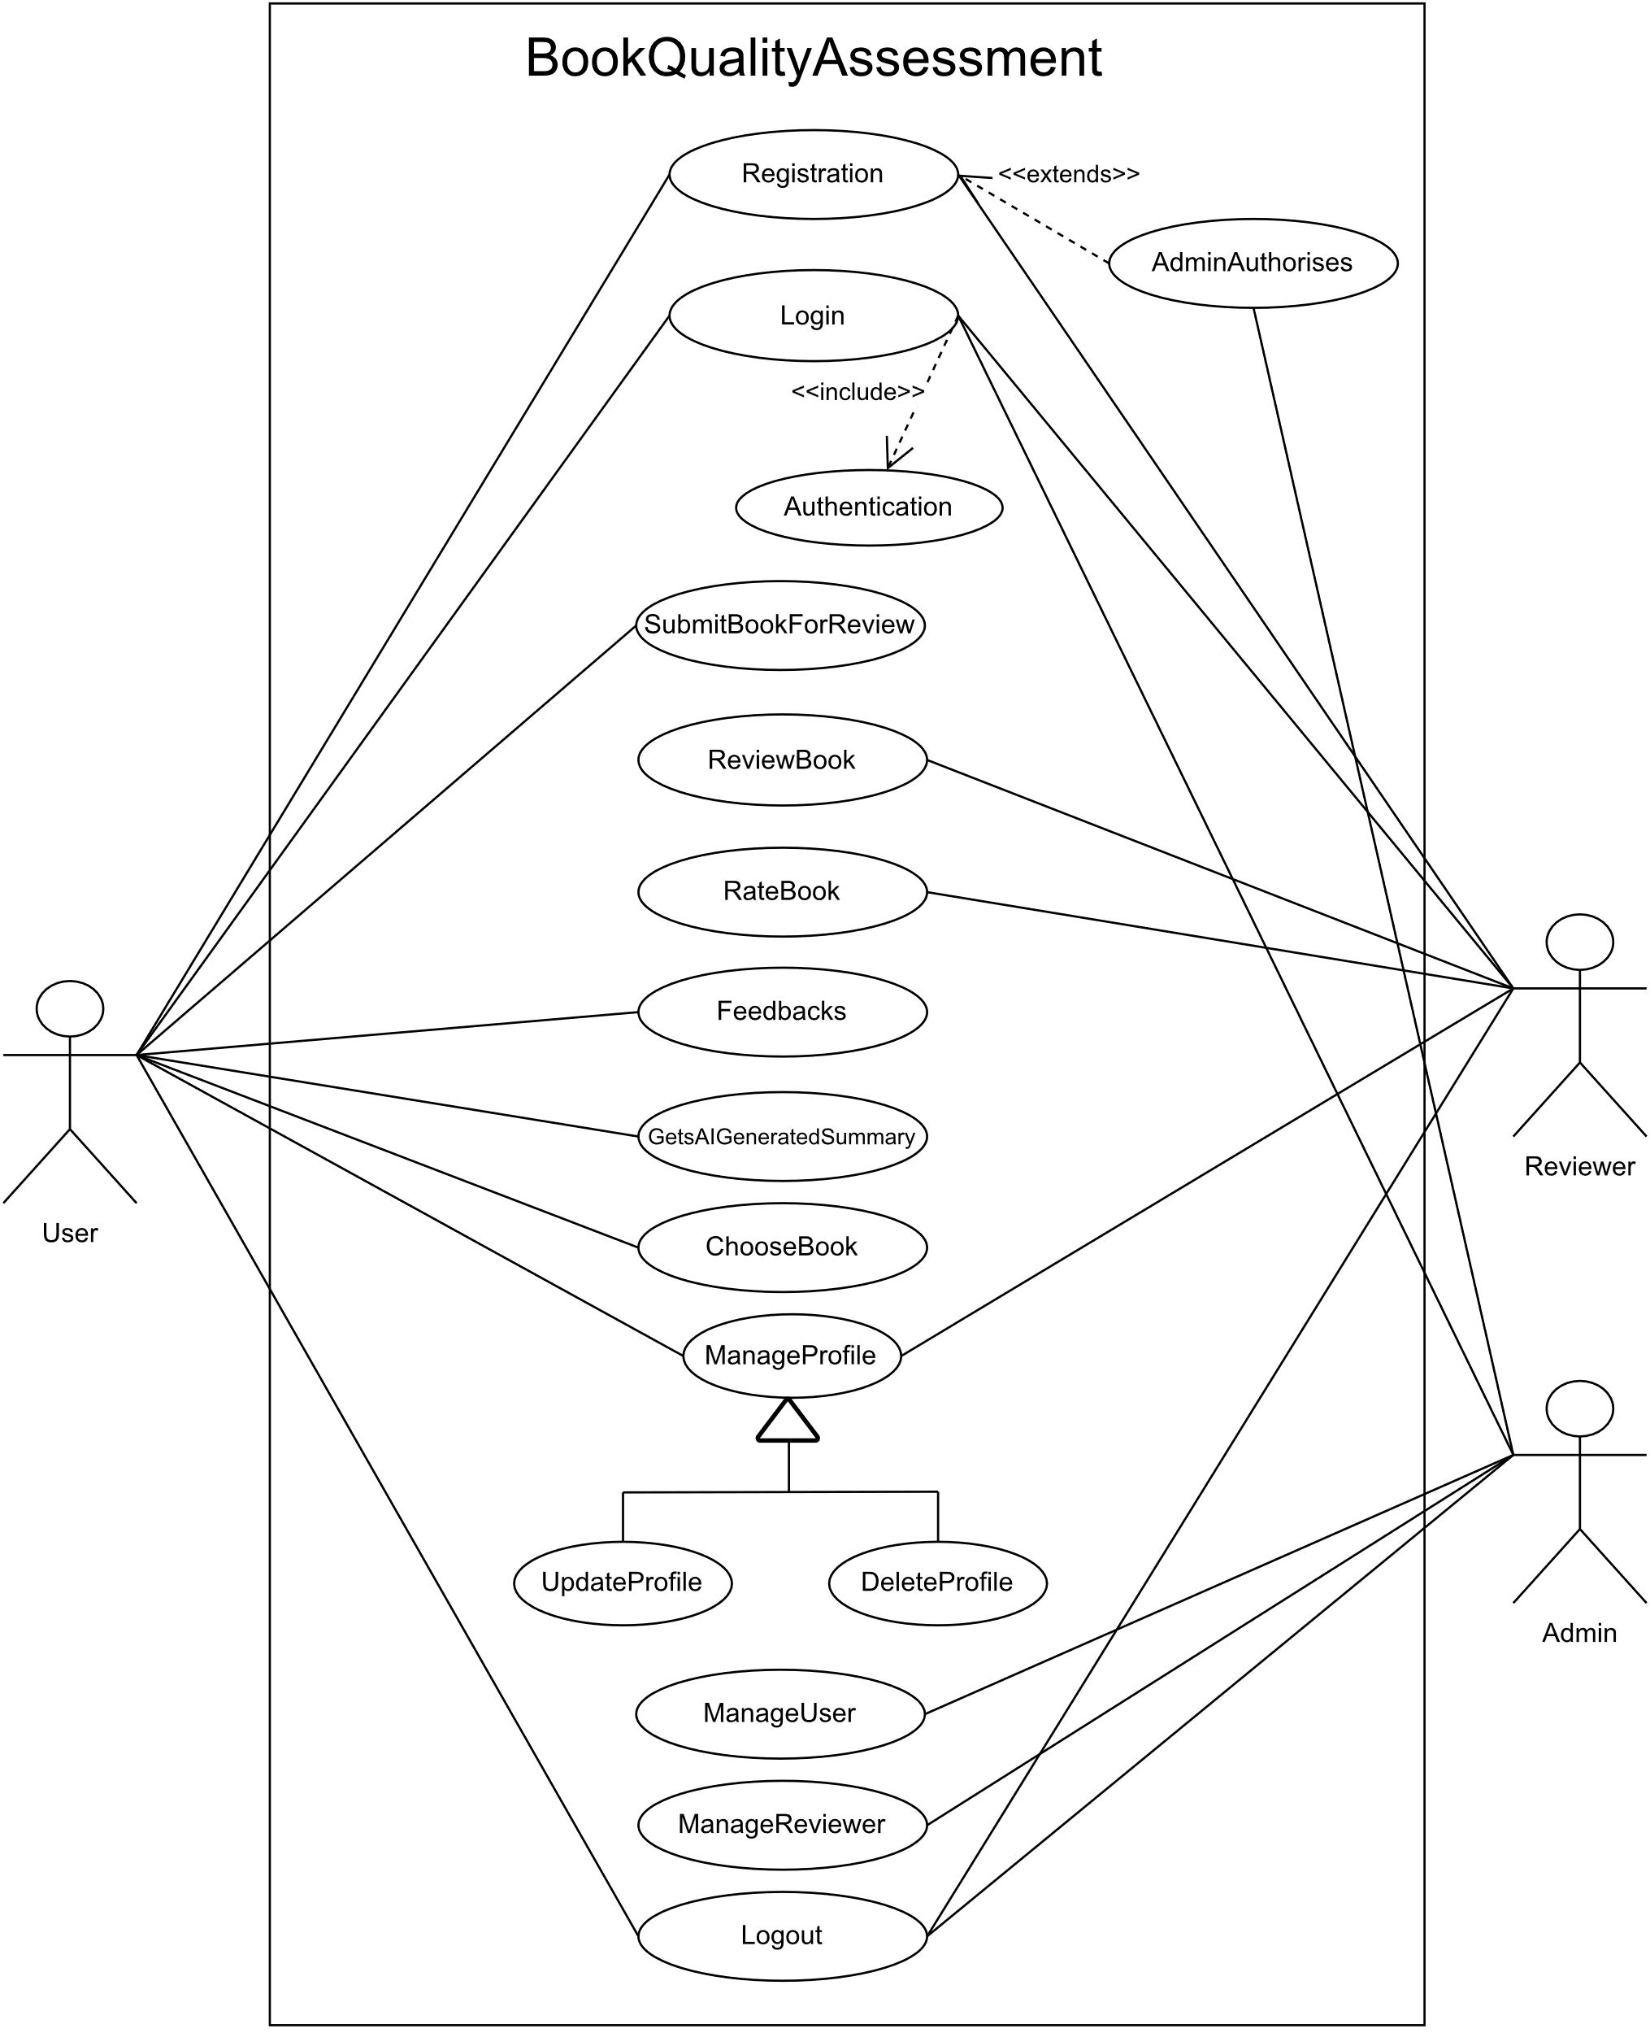
Idea/Approach Details
Use Case
SHOW STOPPER
Dependencies
User interaction features: Submit, review, and rate books, leave comments, and participate in book discussions.
Platform enhancements: Search and browse books, receive recommendations, engage with the community, and access analytics and settings for a personalized reading experience.
The book review application relies on robust dependencies including databases, language processing APIs, server hosting, authentication, and external data sources to provide users with a seamless and feature-rich reading experience.
Summarizing Feedbacks Using AI Capabilities
User views The Assessments
Text To GPT3 Summarization API
API response With Summery
User Gets Summary of All The Reviews

Slide 4
Team Member Details
Team Leader Name: UZZMA SAIYED
Msc. Stream (ECE, CSE etc): Year (I,II,III,IV): I
Team Member 1 Name: SMIT JOSHI
Msc. Stream (ECE, CSE etc): Year (I,II,III,IV): I
Team Member 2 Name: TEJASV MODI
Msc. Stream (ECE, CSE etc): Year (I,II,III,IV): I.
Team Member 3 Name: KHUSHI LODHA
Msc. Stream (ECE, CSE etc): Year (I,II,III,IV): I
Team Member 4 Name: DIGVIJAY JAKHANIYA
Msc. Stream (ECE, CSE etc): Year (I,II,III,IV): I
Team Member 5 Name: VISHVA RAVAL
Msc. Stream (ECE, CSE etc): Year (I,II,III,IV): I
Team Mentor 1 Name: PROF. RACHANA CHAUDHARI
Category : Academic Expertise: Web and Mobile Development Domain Experience (in years): 9

